Slide 1

Department of Computer Science and Engineering
TG
BANGALORE
MAJOR PROJECT
MINDOVA ONLINE LEARNING PLATFORM
Ankitha Acharya (TG02WD0265)
Guide:Mr.Likhith

Slide 2
•Abstract
•Introduction
•Objective
•Problem Definition
•Scope
•Methodology
•Experimental Setup
•Results or Findings
•Summary Table
•Discussion
•Proposed System
•Feasibility Study
•Workflow
•Methods and Techniques Used
•Progress in Project
•Results
•Conclusion
•References

Slide 3
ABSTRACT
Mindova Learning Application is a modern online learning platform developed using MERN stack technologies including MongoDB, Express.js, React.js, and Node.js. The application provides secure user authentication, responsive UI design, and easy access to educational resources through an interactive and user-friendly interface.
The platform allows students to enroll in courses, watch video lectures, attempt quizzes, track learning progress, and download course completion certificates. Instructors can create and manage courses, while administrators can monitor users, enrollment requests, and overall system performance through a centralized dashboard.
The project demonstrates practical implementation of full-stack web development concepts such as frontend-backend integration, REST API communication, database management, JWT authentication, responsive web design, and deployment using Vercel and Render. It also highlights the importance of digital learning systems in improving accessibility, flexibility, and online education management.

Slide 4
INTRODUCTION
Online learning platforms are becoming important in modern education
Traditional learning systems often lack flexibility and accessibility
Students need a centralized platform for managing learning resources
Mindova provides an organized and interactive learning environment
Includes features like authentication, dashboard, and course access
Designed using MERN stack technologies
Responsive interface supports mobile, tablet, and desktop devices
Helps users access educational content anytime and anywhere
Provides smooth navigation and better user experience
Improves practical understanding of full-stack web development
Supports digital learning and skill development
Makes learning resources easily accessible and manageable

Slide 5
Objectives
To develop a responsive online learning platform using MERN stack
To provide secure login and registration functionality
To create a user-friendly and modern interface
To organize educational content effectively
To improve accessibility for learners on different devices
To integrate frontend, backend, and database operations
To implement secure authentication using JWT
To gain practical knowledge of full-stack web development
To deploy the application using modern hosting platforms
To support future enhancements like quizzes and certifications

Slide 6
Problem Definition
Many traditional learning systems lack proper organization, responsiveness, and interactive features. Students often face difficulties in accessing learning resources through a single platform. Mindova solves this problem by providing a centralized and responsive online learning application with secure authentication and efficient course management.

Slide 7
Scope of the Project
User registration and login system
Secure authentication using JWT
Course access and management
Video learning modules for students
Online quizzes for knowledge assessment
Responsive dashboard for better user experience
Database integration using MongoDB
REST API communication between frontend and backend
Certificate generation for completed courses
Future support for AI-based recommendations and admin dashboard

Slide 8
Technologies Used
Frontend
React.js
Tailwind CSS
Vite
React Router DOM
Backend
Node.js
Express.js
Database
MongoDB
Mongoose
Tools
VS Code
GitHub
Postman
Deployment
Vercel
Render

Slide 9
Methodology
Requirement analysis was performed to understand user needs
Planned the structure and workflow of the application
Designed responsive UI using React.js and Tailwind CSS
Developed frontend pages for dashboard, videos, and quizzes
Created backend APIs using Node.js and Express.js
Implemented secure authentication using JWT
Integrated MongoDB database for storing application data
Added video learning modules and quiz functionality
Tested responsiveness, APIs, and database operations
Deployed the frontend on Vercel and backend on Render

Slide 10
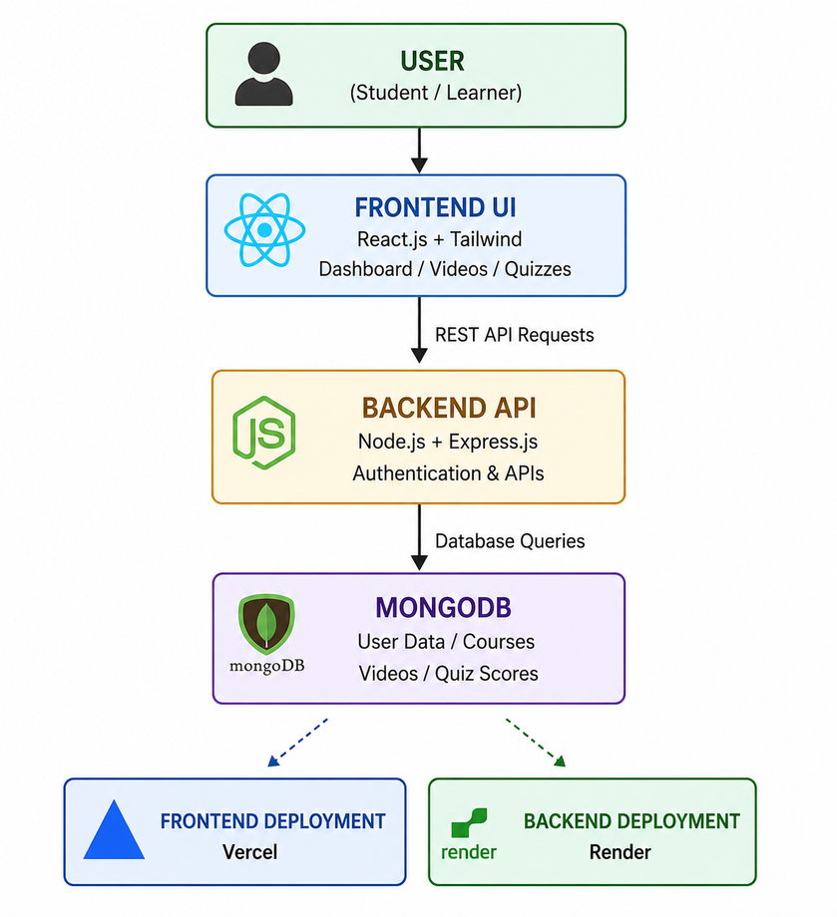
System Architecture
Users interact with the application through the frontend interface developed using React.js and Tailwind CSS.
The frontend sends API requests to the backend server.
The backend developed using Node.js and Express.js handles authentication, course management, quizzes, and videos.
MongoDB stores user details, course information, quiz results, and learning data.
The frontend is deployed on Vercel and the backend is hosted on Render.

Slide 11
Features
System Features
JWT-Based Authentication System
REST API Integration
MongoDB Database Connectivity
Secure Backend Architecture
Fast and Smooth Performance
Frontend-Backend Communication
Responsive UI using Tailwind CSS
Scalable MERN Stack Architecture
Real-Time Data Handling
Deployment using Vercel and Render
User Features
User Registration System
Secure Login and Authentication
Interactive User Dashboard
Video Learning Modules
Online Quiz Functionality
Course Access and Management
Responsive Design for All Devices
Progress Tracking System
Certificate Access After Completion
Easy Navigation and User-Friendly Interface

Slide 12
Experimental Setup
React.js and Tailwind CSS used for frontend development
Node.js and Express.js used for backend API creation
MongoDB used for database management
JWT authentication implemented for secure login
Video learning modules integrated into the system
Quiz functionality added for student assessment
Application tested on desktop and mobile devices
Browser compatibility checked using Chrome and Edge
Frontend deployed on Vercel platform
Backend server hosted on Render platform

Slide 13
Results / Findings
Responsive online learning platform developed successfully
Secure login and authentication system implemented
Smooth frontend and backend communication achieved
Video learning modules working efficiently
Quiz functionality successfully integrated
MongoDB database storing user and course data properly
Fast loading speed and smooth navigation observed
User-friendly dashboard improved learning experience
Application tested successfully on multiple devices
Frontend and backend deployed successfully using Vercel and Render

Slide 14
Summary Table
Feature | Description | Result
User Authentication | Secure login and registration system | Improved security
Dashboard | Interactive learning dashboard | Better user experience
Video Modules | Online video learning support | Easy understanding
Quiz System | Conducts quizzes and assessments | Knowledge evaluation
MongoDB Database | Stores user and course data | Efficient data management
REST APIs | Connects frontend and backend | Smooth communication
Responsive Design | Supports all devices | Better accessibility
Course Management | Organizes learning resources | Structured learning
Deployment | Hosted on Vercel and Render | Live accessibility
Performance | Fast loading and smooth navigation | Improved efficiency

Slide 15
Discussion
The project successfully combines frontend, backend, and database technologies
React.js helped in creating reusable and responsive UI components
Node.js and Express.js improved backend API development
MongoDB provided flexible and efficient data management
JWT authentication improved system security and user protection
Video learning modules enhanced interactive learning experience
Quiz functionality helped in student knowledge assessment
Responsive design improved accessibility across all devices
REST APIs ensured smooth communication between frontend and backend
Deployment using Vercel and Render improved online accessibility
The project enhanced practical understanding of MERN-stack development
The application provides a scalable foundation for future enhancements
UI/UX design improved navigation and user interaction
Database integration helped manage users, courses, and quiz data efficiently
The system demonstrates real-world implementation of full-stack web development

Slide 16
Feasibility Study
The project is technically feasible using MERN stack technologies
React.js provides efficient frontend development support
Node.js and Express.js enable smooth backend API creation
MongoDB supports flexible and scalable database management
Open-source technologies reduce overall development cost
Free hosting platforms like Vercel and Render improve economic feasibility
The system is easy to operate and user-friendly
Responsive design ensures accessibility across multiple devices
The project can be completed within the planned development timeline
The application supports future scalability and feature enhancements

Slide 17
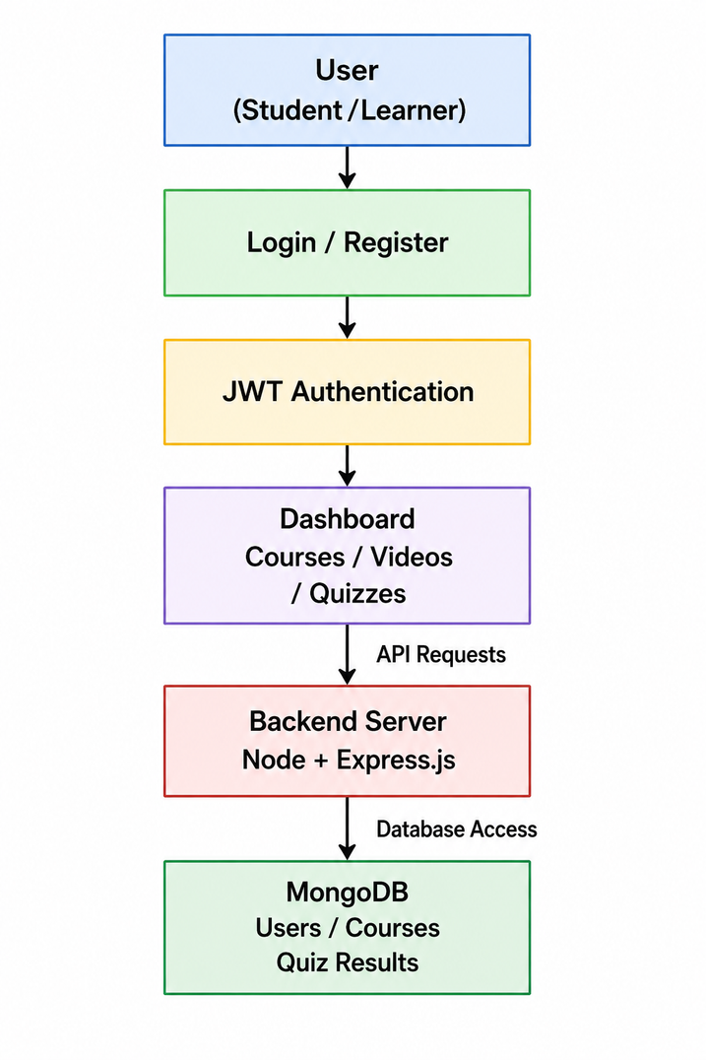
Workflow
User opens the Mindova Learning Application
User registers or logs into the system
Authentication is verified using JWT
Dashboard is displayed after successful login
User accesses courses, videos, and quizzes
Frontend sends API requests to backend server
Backend processes requests using Node.js and Express.js
MongoDB stores and retrieves user and course data
Quiz results and learning progress are updated
User receives smooth and responsive learning experience

Slide 18
Methods and Techniques Used
The workflow of the Mindova Learning Application starts when the user opens the application and performs registration or login using secure authentication. After successful JWT verification, the system grants access to the dashboard where users can explore courses, watch educational videos, attempt quizzes, and track their learning progress.
The frontend interface developed using React.js and Tailwind CSS sends API requests to the backend server created with Node.js and Express.js. The backend processes user requests, handles authentication, manages course data, and communicates with the MongoDB database.
MongoDB stores important information such as user details, course content, video modules, quiz scores, and progress records. The system ensures smooth communication between frontend and backend through REST APIs, providing fast performance, secure access, and responsive user experience across all devices.

Slide 19
Progress in Project
Requirement analysis and project planning completed
Designed the UI layout and overall workflow of the application
Created responsive frontend using React.js and Tailwind CSS
Developed login and registration modules
Implemented JWT authentication for secure access
Created dashboard for courses, videos, and quizzes
Developed backend APIs using Node.js and Express.js
Integrated MongoDB database for data storage
Added video learning and quiz functionalities
Tested responsiveness, APIs, and database operations successfully

Slide 20
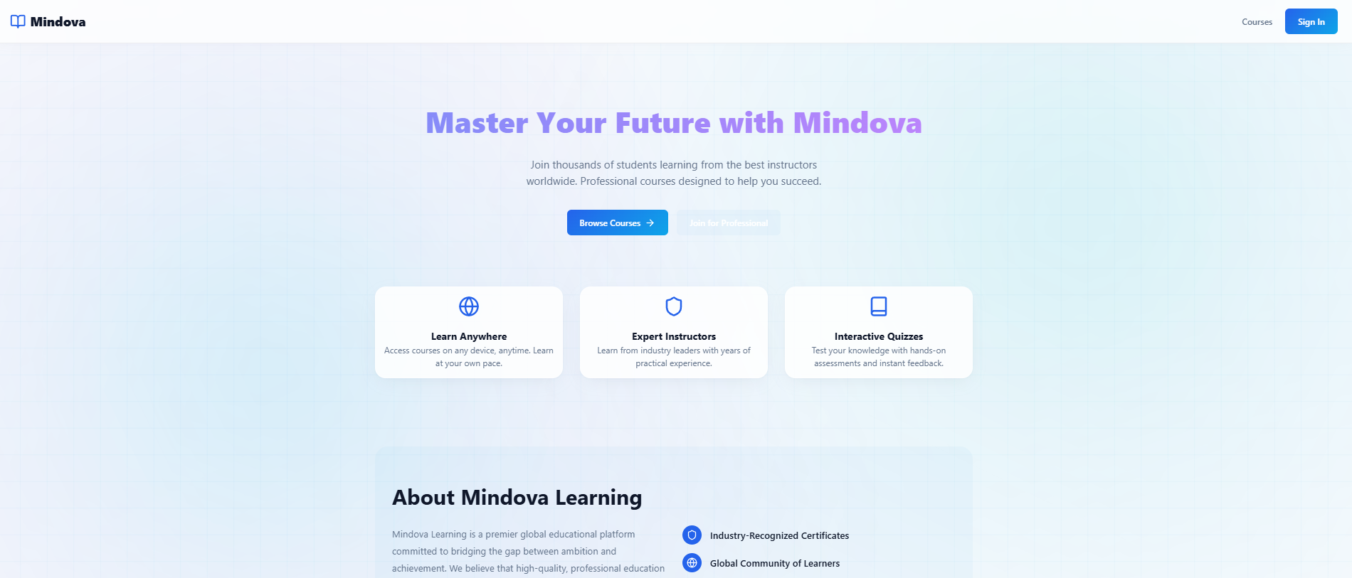
Results
Home page
The Home Page is the landing page of the Mindova Learning Application. It provides an introduction to the platform with attractive UI design and highlights important features such as online courses, expert instructors, and interactive quizzes. Users can browse available courses and access the sign-in page easily. The responsive design ensures smooth accessibility across different devices.

Slide 21
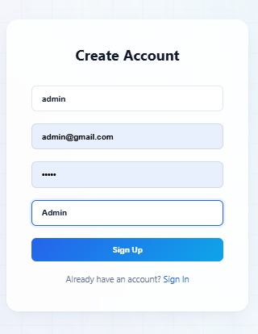
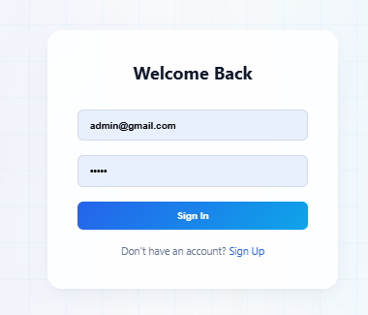
Registration Page
Login Page
The User Registration and Login Module provides secure access to the Mindova Learning Application. New users can create an account by entering details such as username, email address, password, and selecting their role as Student, Instructor, or Admin. The system validates and securely stores user information in the MongoDB database.
Registered users can log into the platform using their email and password credentials. After successful JWT authentication, users are redirected to their respective dashboards based on their roles. This module ensures secure authentication, role-based access control, smooth navigation, and improved user experience within the learning platform.

Slide 22
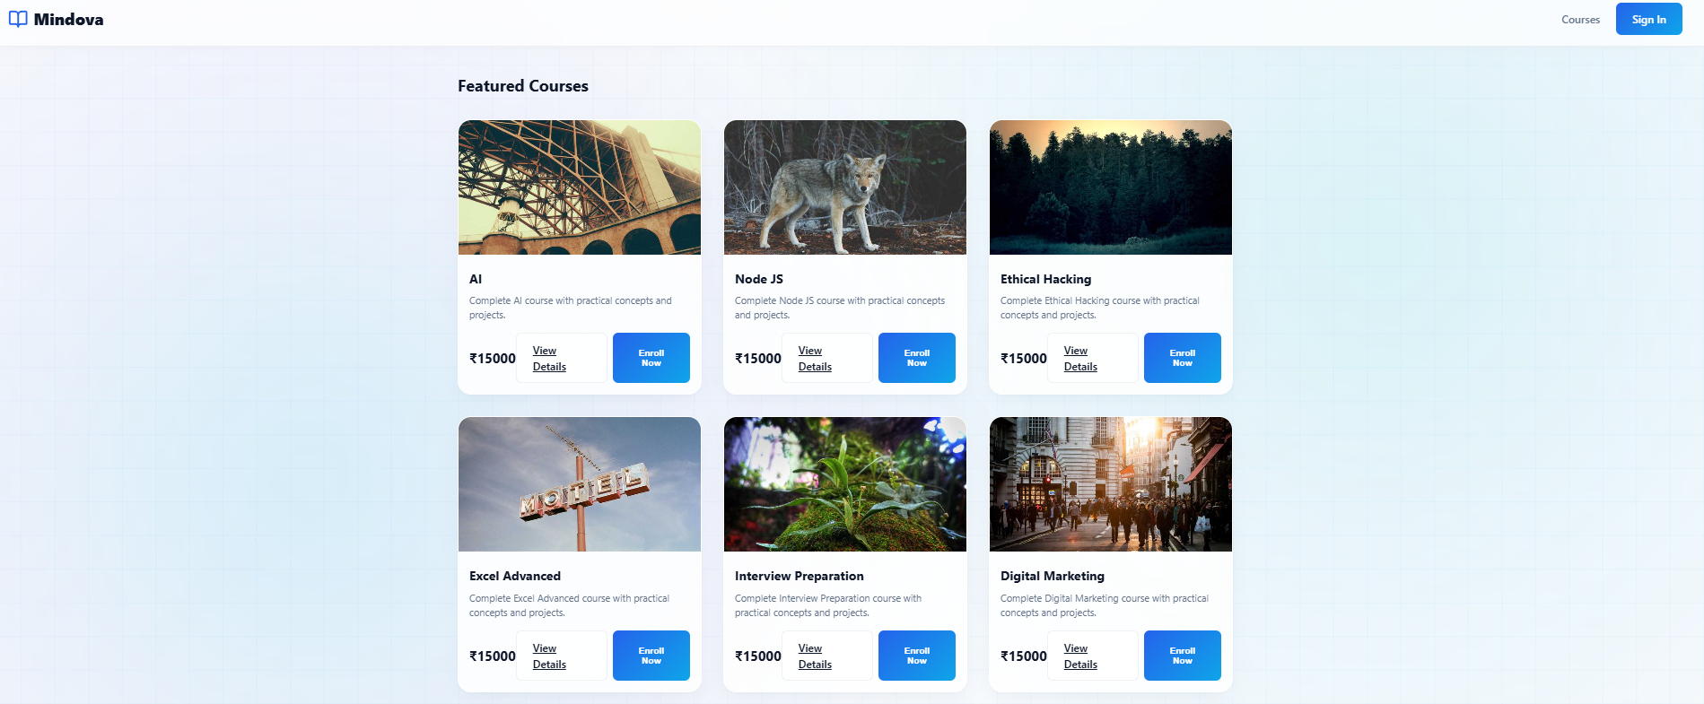
Featured Courses Page
The Featured Courses section displays various technical and professional courses available on the platform. Each course card contains course title, description, pricing, and enrollment options. This section helps learners explore courses such as AI, Web Development, Machine Learning, SQL, and Android Development etc...in an organized manner.

Slide 23
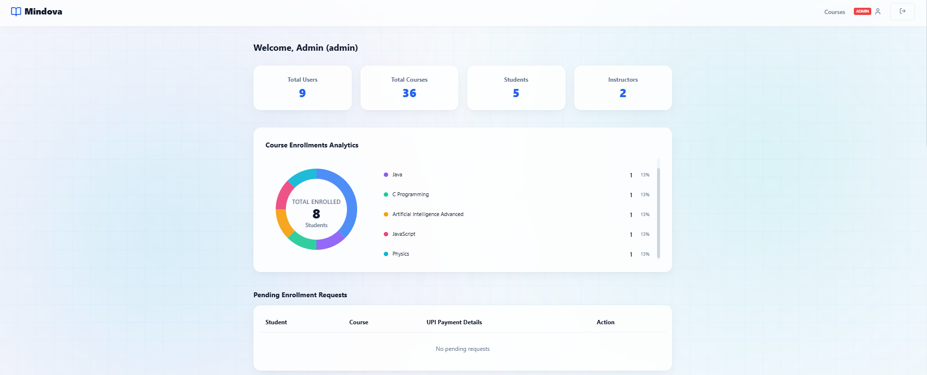
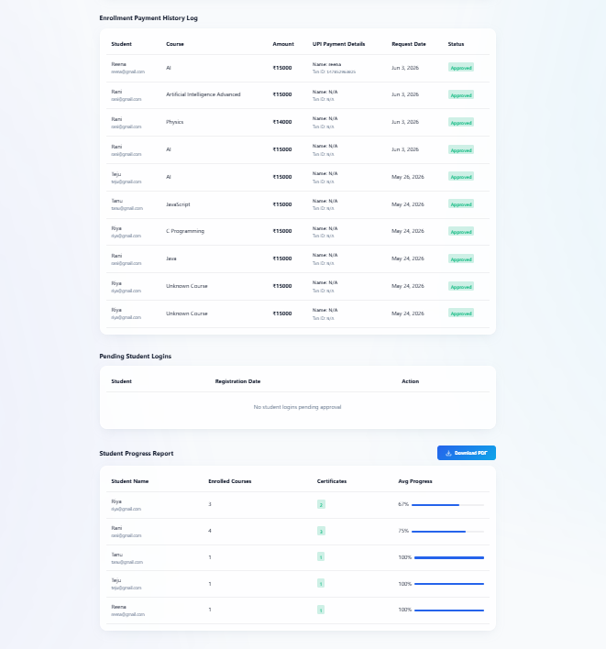
Admin Dashboard
The Admin Dashboard provides complete control over the learning platform. Admins can monitor total users, courses, students, and instructors. The dashboard also manages enrollment requests and generates student progress reports for better system administration.

Slide 24
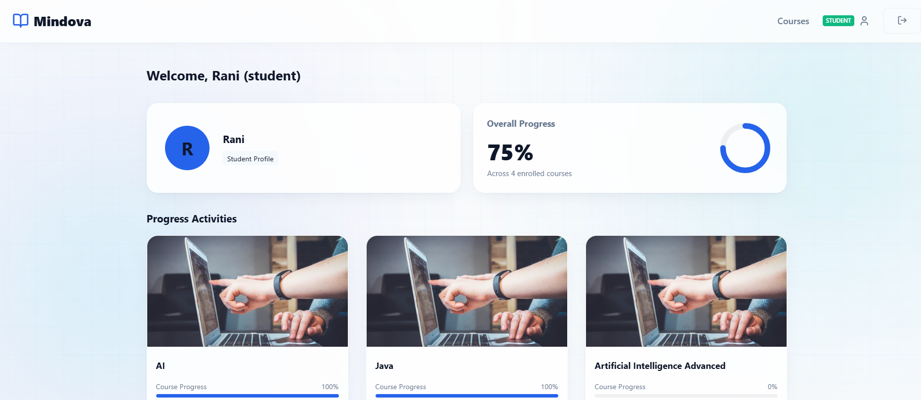
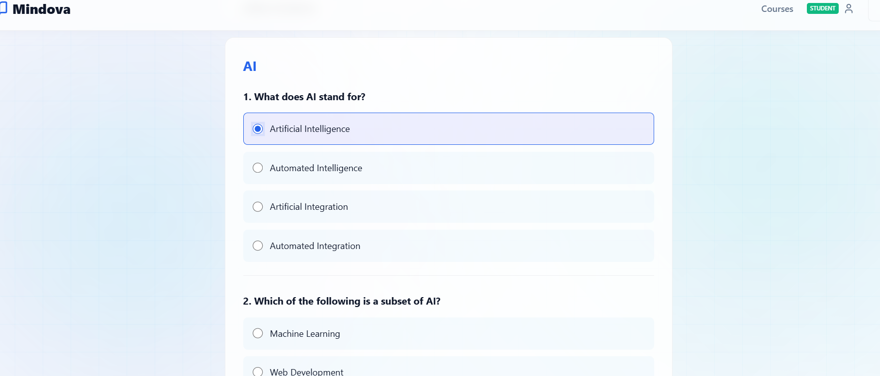
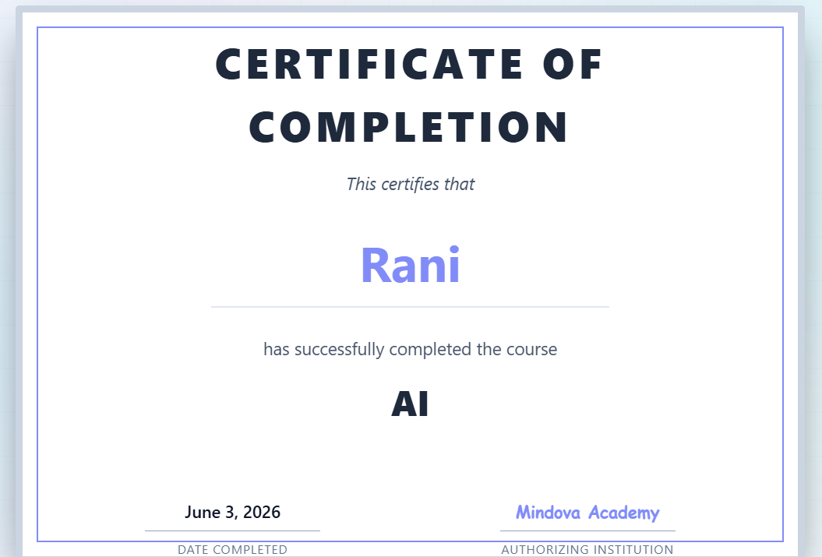
Student Dashboard
Quiz Page
Certificate Generation Page

Slide 25
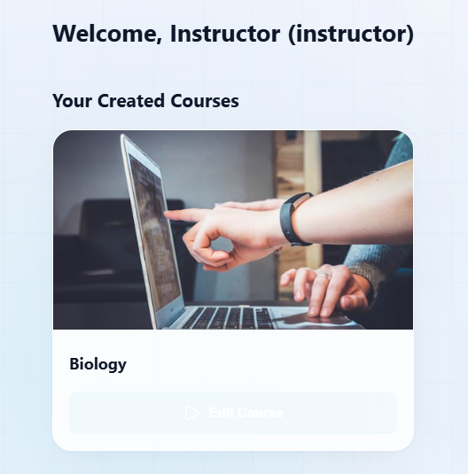
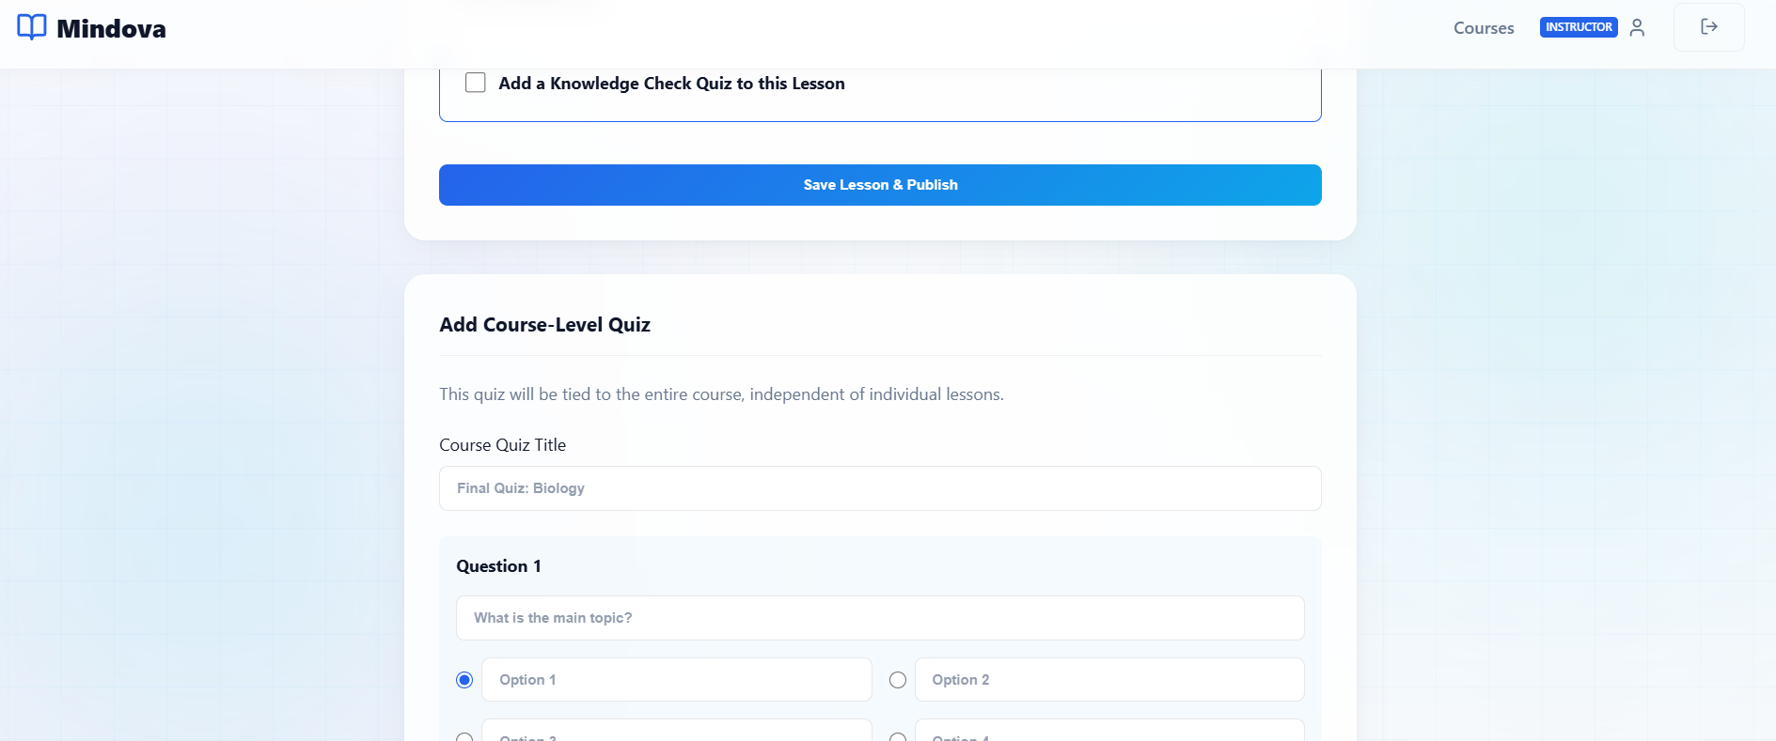
The Student Dashboard allows students to access enrolled courses, track learning progress, watch videos, attempt quizzes, and monitor course completion status. The Quiz Module helps assess student knowledge through multiple-choice questions, while the Certificate Generation Module provides downloadable certificates after successful course completion.
Instructor Course Management
The Instructor Dashboard allows instructors to create and manage courses. Instructors can add course titles, descriptions, pricing details, and video links. This feature helps instructors upload educational content and manage learning resources efficiently.
Link of project: https://mindova-learning-application-rioo5qcyr.vercel.app

Slide 26
Conclusion
The Mindova Learning Application successfully provides a responsive and secure online learning platform developed using MERN stack technologies. The project integrates features such as user authentication, course management, video learning, quizzes, progress tracking, and certificate generation into a single system.
The application improves accessibility and provides a smooth learning experience through an interactive and user-friendly interface. It also enhanced practical understanding of frontend development, backend integration, database management, API communication, and deployment processes. Overall, the project demonstrates effective implementation of full-stack web development concepts and supports future enhancements for advanced online learning systems.

Slide 27
References
React Documentation – Used for developing responsive frontend components and managing the user interface.
Link: https://react.dev
Node.js Documentation – Referred for backend server development and API handling.
Link: https://nodejs.org
Express.js Documentation – Used for creating REST APIs and backend routing functionality.
Link: https://expressjs.com
MongoDB Documentation – Helped in database integration and data management.
Link: https://www.mongodb.com/docs
Tailwind CSS Documentation – Used for responsive UI design and frontend styling.
Link: https://tailwindcss.com
JWT Official Website – Referred for implementing secure authentication and authorization.
Link: https://jwt.io
MDN Web Docs – Used for learning JavaScript concepts and modern web technologies.
Link: https://developer.mozilla.org
W3Schools – Used for understanding frontend and backend development concepts with examples.
Link: https://www.w3schools.com
Vercel Documentation – Used for frontend deployment and hosting setup.
Link: https://vercel.com
Render Documentation – Used for backend deployment and server hosting.
Link: https://render.com

Slide 28
THANK YOU

